Slide 1
Parallel and Distributed Computing
CS3006
Lecture 6
Decomposition Techniques
9th March 2022
Dr. Rana Asif Rehman

Slide 2
Agenda
A Quick Review
Decomposition Techniques
Recursive
Data-decomposition
Exploratory
Speculative
Hybrid

Slide 3
Quick Review to the Previous Lecture
Parallel Algorithm Design Life Cycle
Tasks, Decomposition, and Task-dependency graphs
Granularity
Fine-grained
Coarse-grained
Concurrency
Max-degree of concurrency
Critical path length
Average-degree of concurrency

Slide 4
Decomposition Techniques
The process of decomposing larger problems into smaller tasks for concurrent executions, is known to as decomposition.
The techniques that facilitate this decomposition are known to as decomposition techniques.
Common techniques:
Recursive
Data-decomposition
Exploratory decomposition
Speculative decomposition
Hybrid
Recursive and data decompositions are relatively general purpose
Exploratory and speculative are special purpose in nature

Slide 5
Decomposition Techniques
1. Recursive Task Decomposition
Recursive decomposition is a method for inducing concurrency in the problems that can be solved using divide and conquer strategy
Divides each problem into a set of independent sub-problems
Each one of these subproblems is solved by recursively applying a similar division into smaller subproblems followed by a combination of their results
A natural concurrency exists as different subproblems can be solved concurrently.

Slide 6
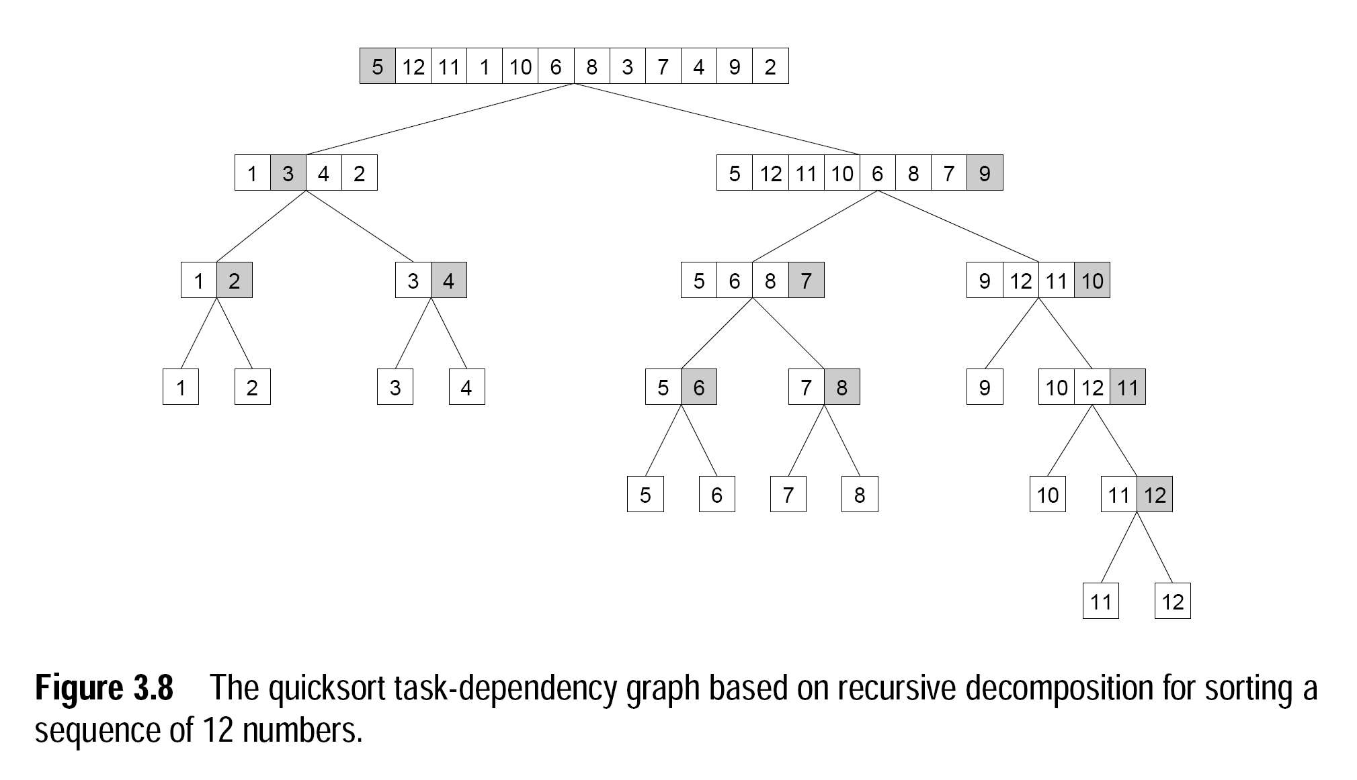
Decomposition Techniques
Recursive Decomposition (Example: Quick sort)
Notes:
Task: The work of partitioning a given subsequence is considered as a task
1st step: only one process is active. Parallelism increases as number of subproblems increases

Slide 7
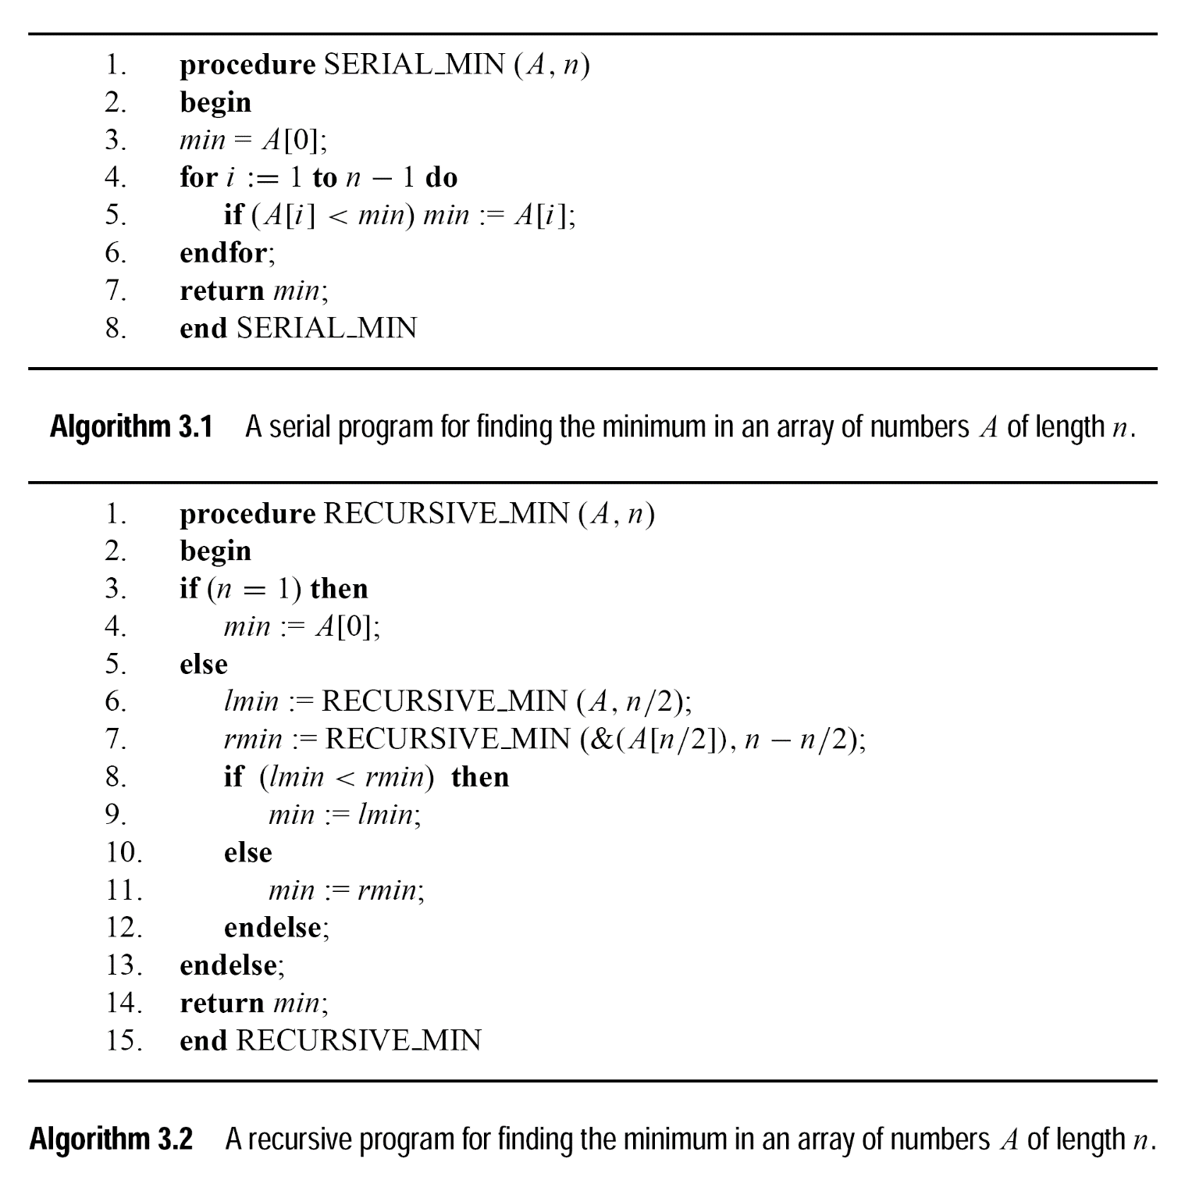
Decomposition Techniques
Recursive Decomposition (Modifying simple problem to support recursive decomposition)
Notes:
Task: The work of partitioning a given subsequence is considered as a task

Slide 8
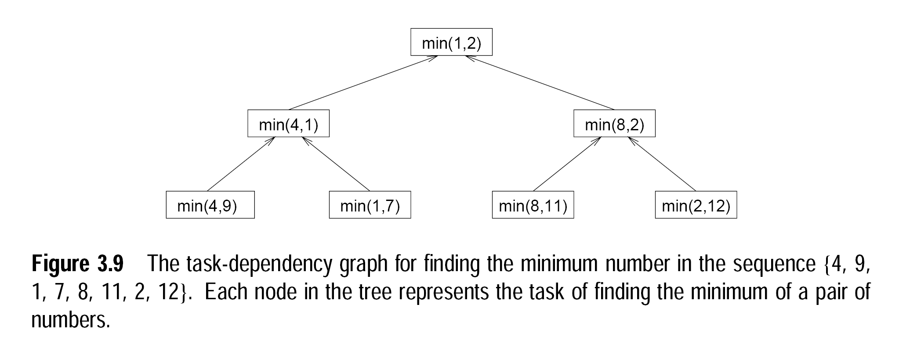
Decomposition Techniques
Recursive Decomposition (Modifying simple problem to support recursive decomposition)
Notes:
Task: each task is assigned the work of finding minimum of the two numbers

Slide 9
Decomposition Techniques
2. Data Decomposition
Powerful and commonly used method
Two step procedure:
Partition data on which computation is to be performed
This data partitioning is used to induce a partitioning of the computations into tasks.
Partitioning output data
Used where each element of the output can be computed independently of others as a function of the input.
Partitioning of the output data automatically induces a decomposition of the problems into tasks
each task is assigned the work of computing a portion of the output

Slide 10
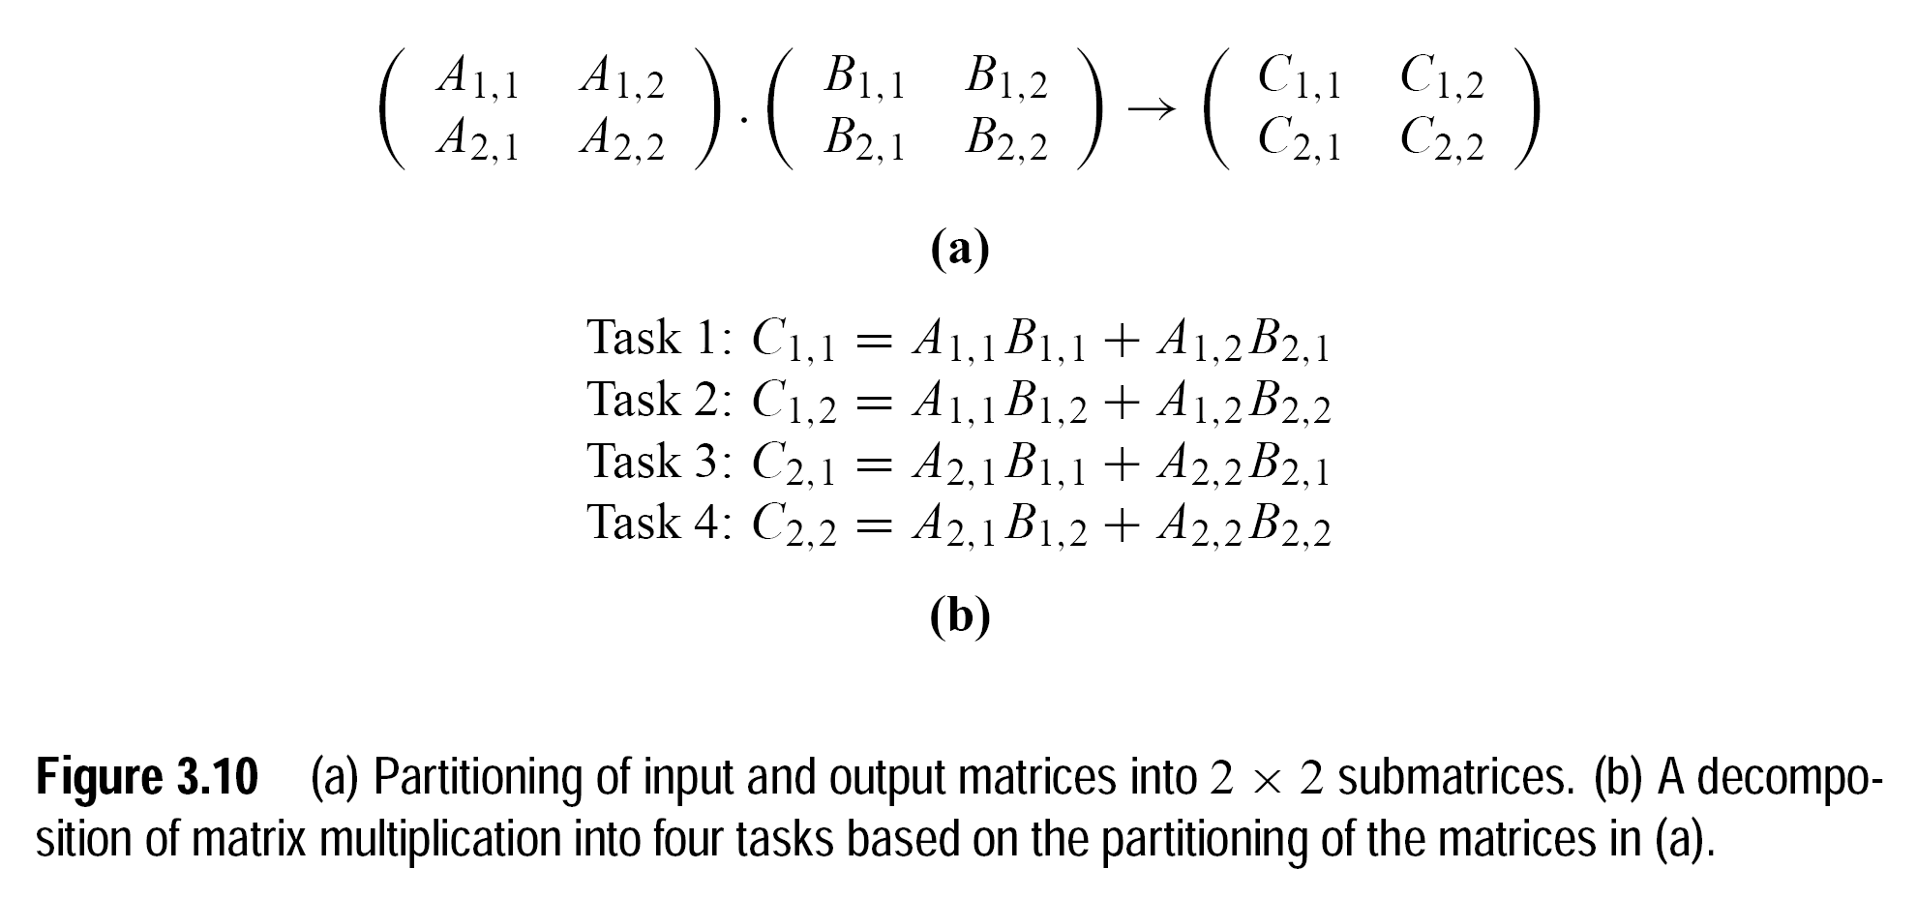
Decomposition Techniques
Data Decomposition (Partitioning Output Data)

Slide 11
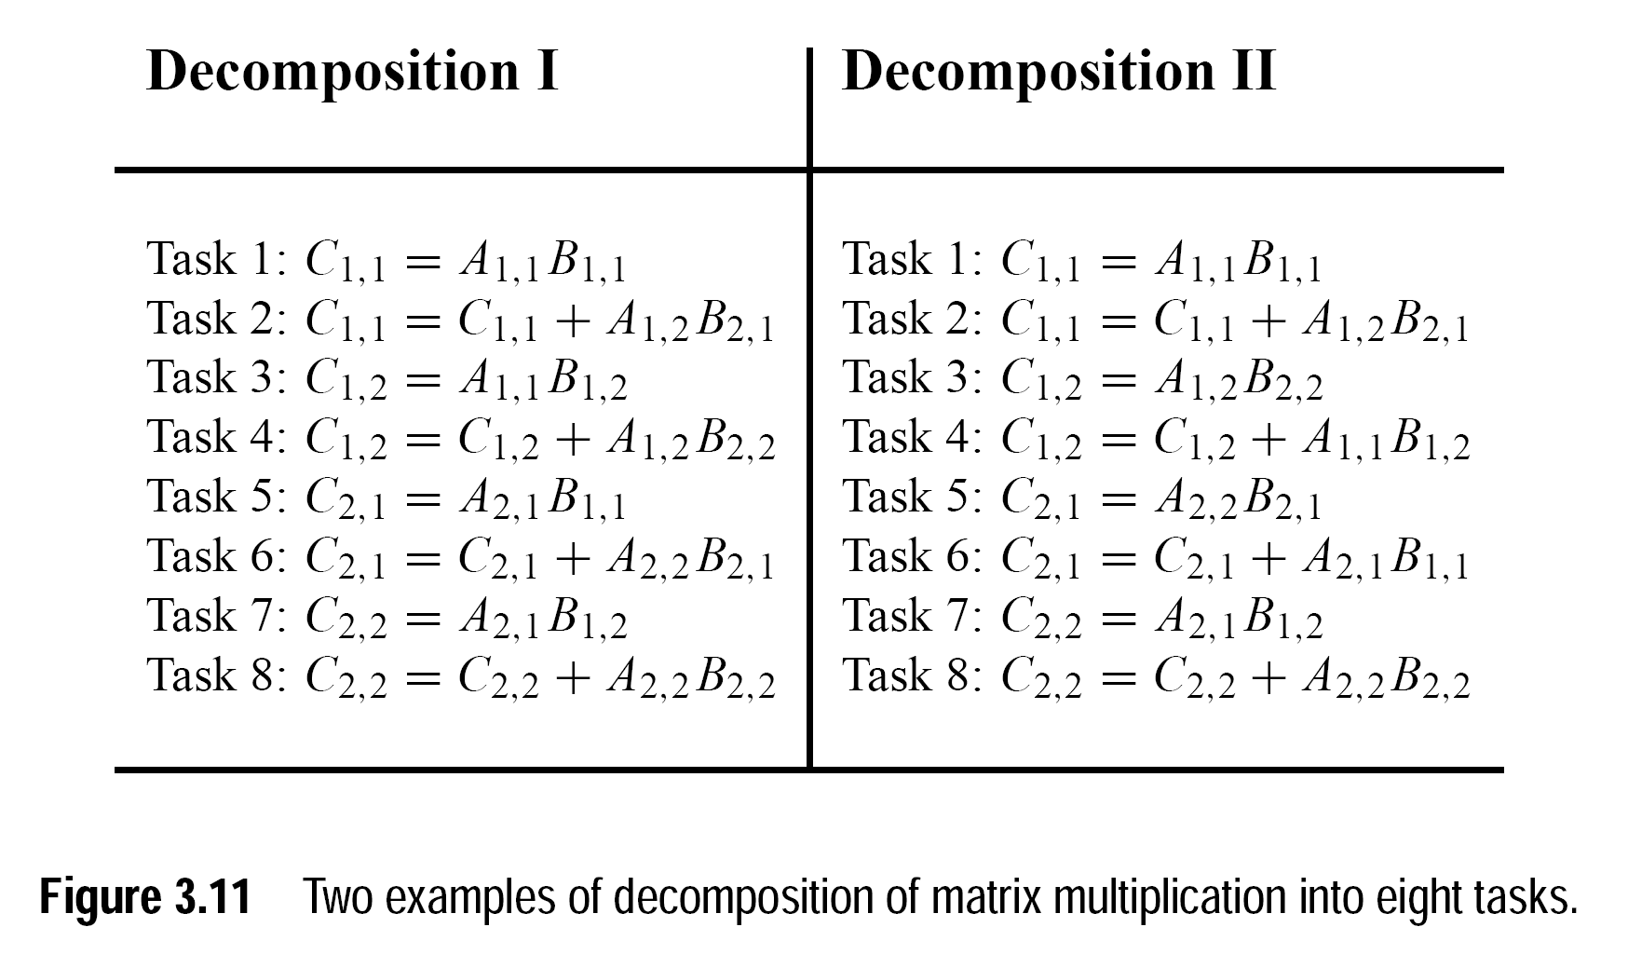
Decomposition Techniques
Data Decomposition (Partitioning Output Data)

Slide 12
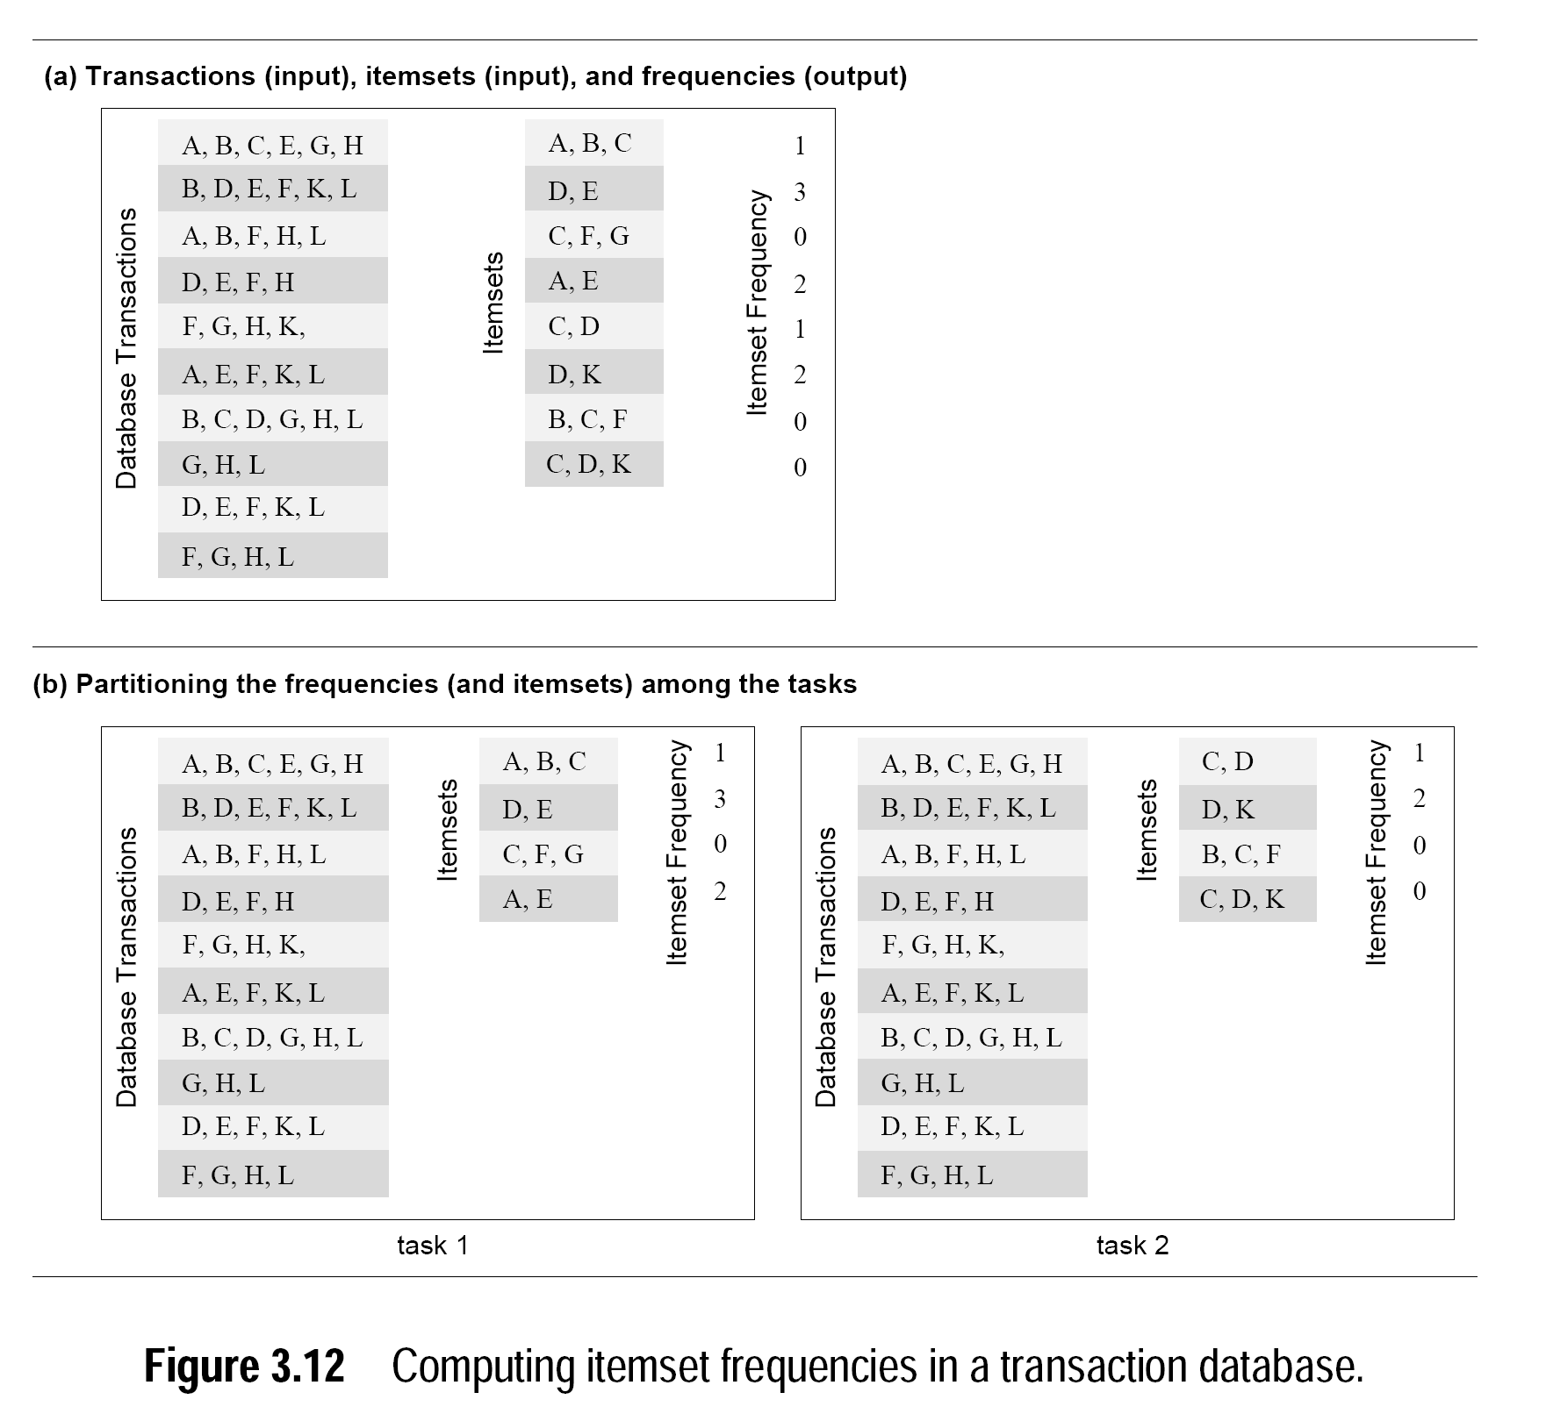
Decomposition Techniques
(Partitioning Output Data)

Slide 13
Decomposition Techniques
Data Decomposition
Partitioning input data
In many algorithms, it is not possible or desirable to partition the output data.
The output may be a single unknown value. Such as in case of finding sum, minimum, maximum or frequencies of a number.
It is sometimes possible to partition the input data, and then use this partitioning to induce concurrency
A task is created for each partition of the input data and this task performs as much computation as possible using these local data
Then local solutions are combined to generate a global solution
Notes:
e.g., finding sum of N sized array using p processors

Slide 14
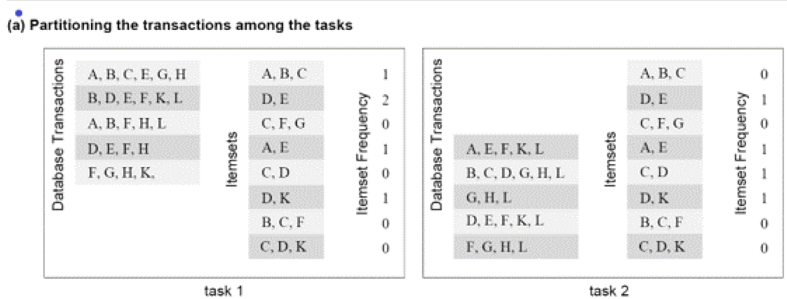
Decomposition Techniques
Partitioning input data
Notes:
Adding frequencies of both the tasks will result in global solution

Slide 15
Decomposition Techniques
Data Decomposition
Partitioning both input and output data
Consider the problems where output data-partitioning is possible
Here, partitioning the input also, can offer additional concurrency
The next example shows 4-way decomposition of the previous example based on both input-output partitioning.

Slide 16
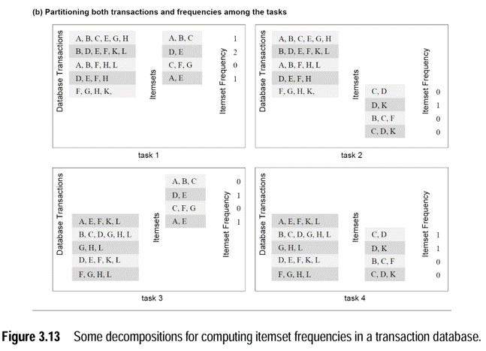
Decomposition Techniques
Partitioning both input and output data
Notes:
Global result shall be obtained by adding results of the tasks:-
task1 and task3
Task 2 and task 4

Slide 17
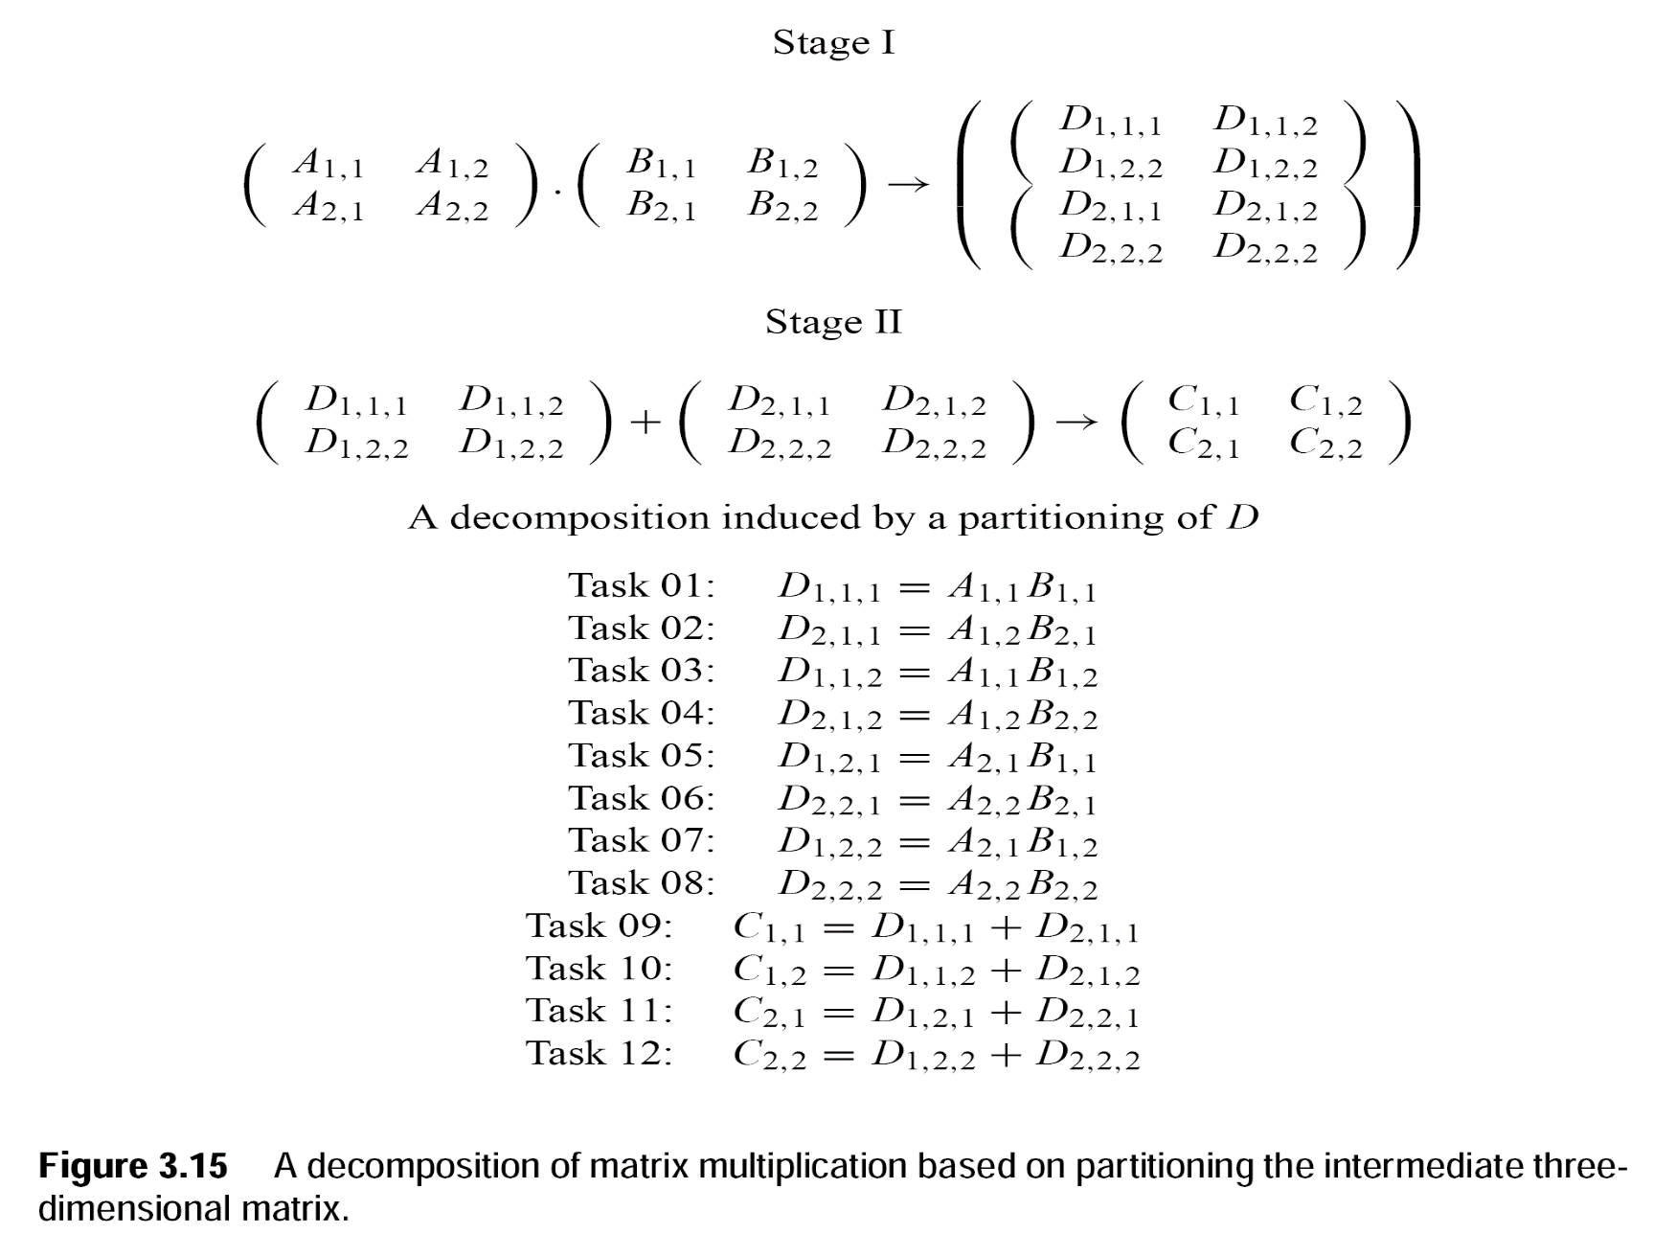
Decomposition Techniques
Partitioning both intermediate data

Slide 18
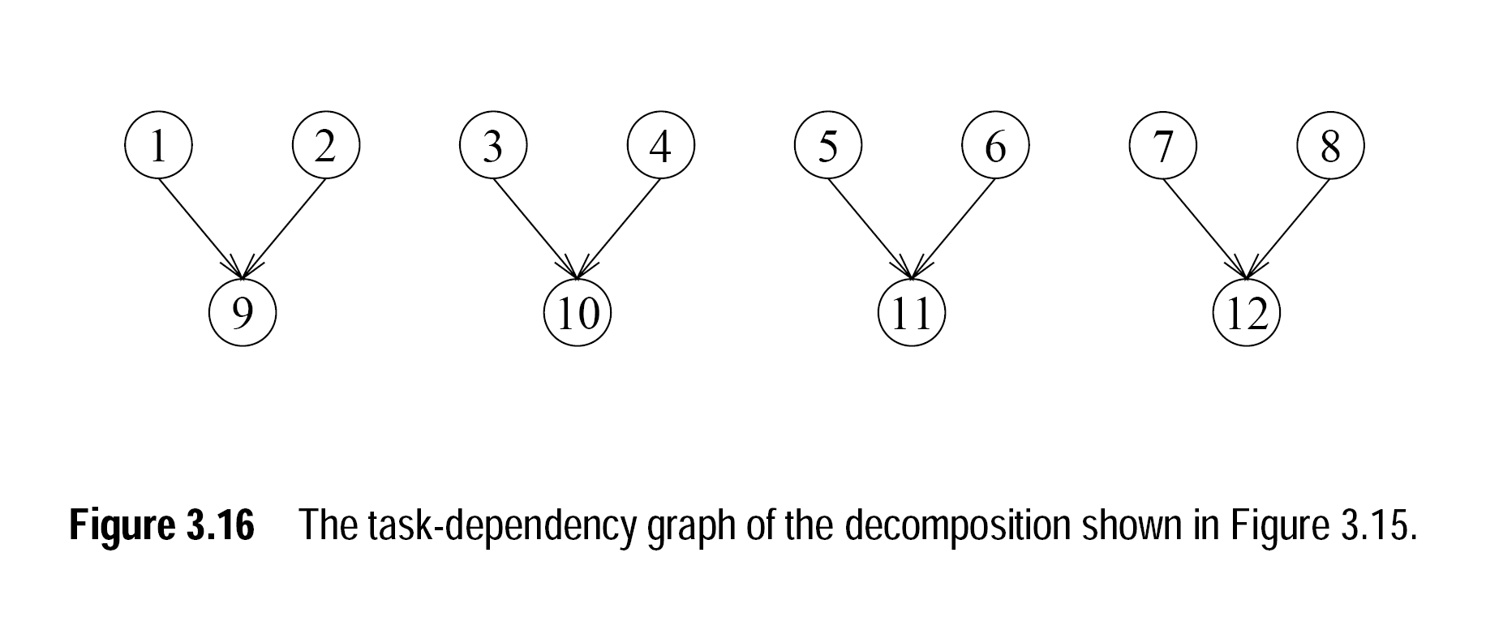

Slide 19
Decomposition Techniques
Owner Compute Rule
Task decomposition based on data-partitioning is widely known as owner compute rule.
Two types of partitioning hence, two definitions:
If we assign partitions of the input data to tasks:
The rule means that a task performs all the computations that can be done using these data
If we assign partition of output data to the tasks:
The rule means that a task computes all the data in the partition assigned to it (portion of theoutput).

Slide 20
Decomposition Techniques
3. Exploratory Decomposition
Specially used to decompose the problems having underlying computation like search-space exploration.
Steps:
Partition the search space into smaller parts
Search each one of these parts concurrently, until the desired solutions are found.

Slide 21
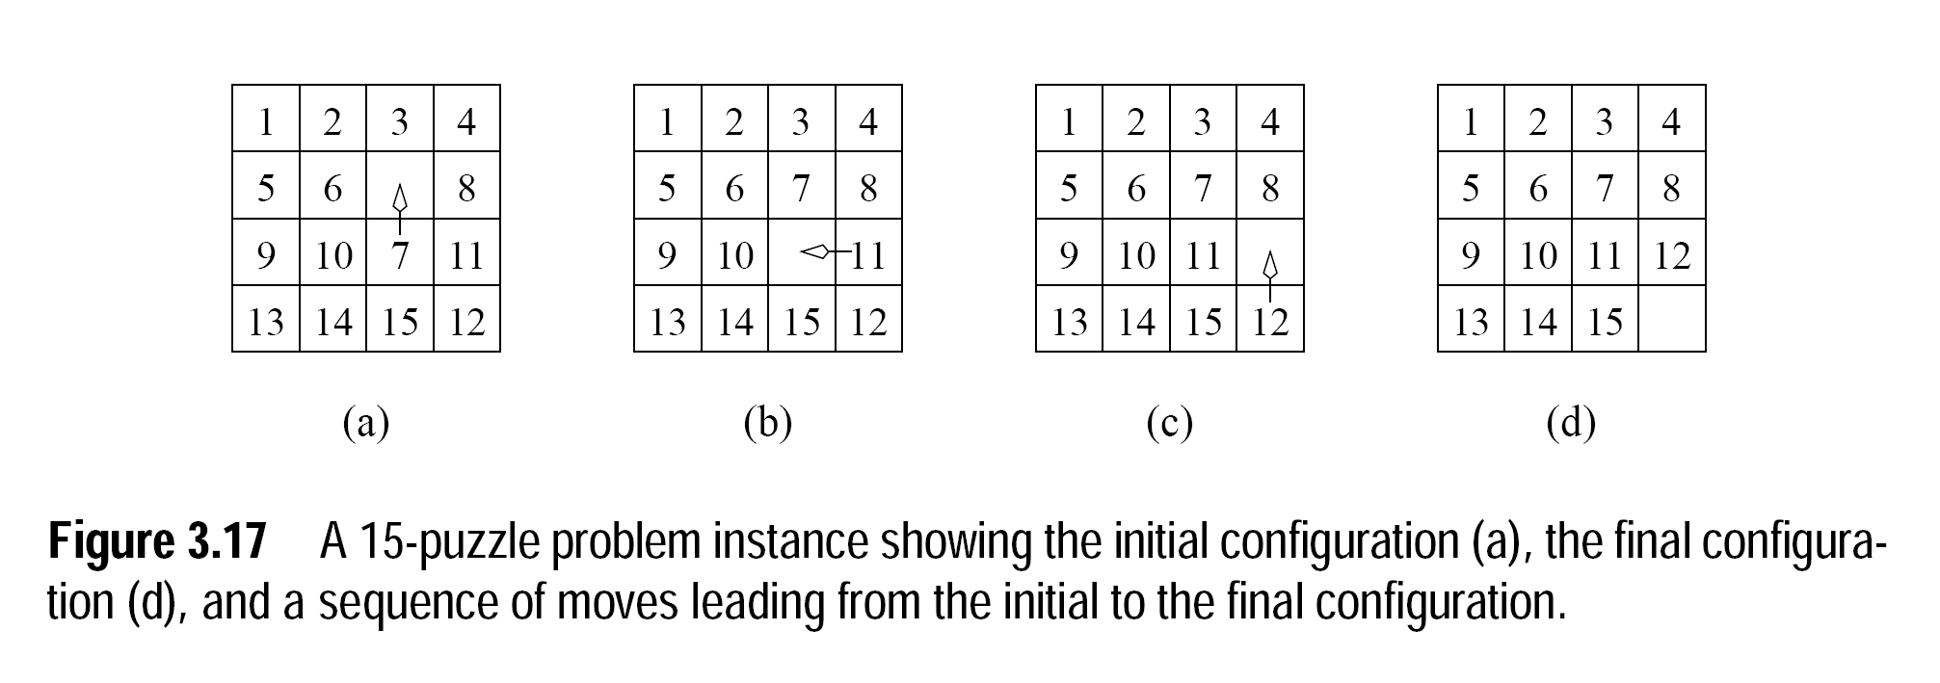
Decomposition Techniques
3. Exploratory Decomposition

Slide 22
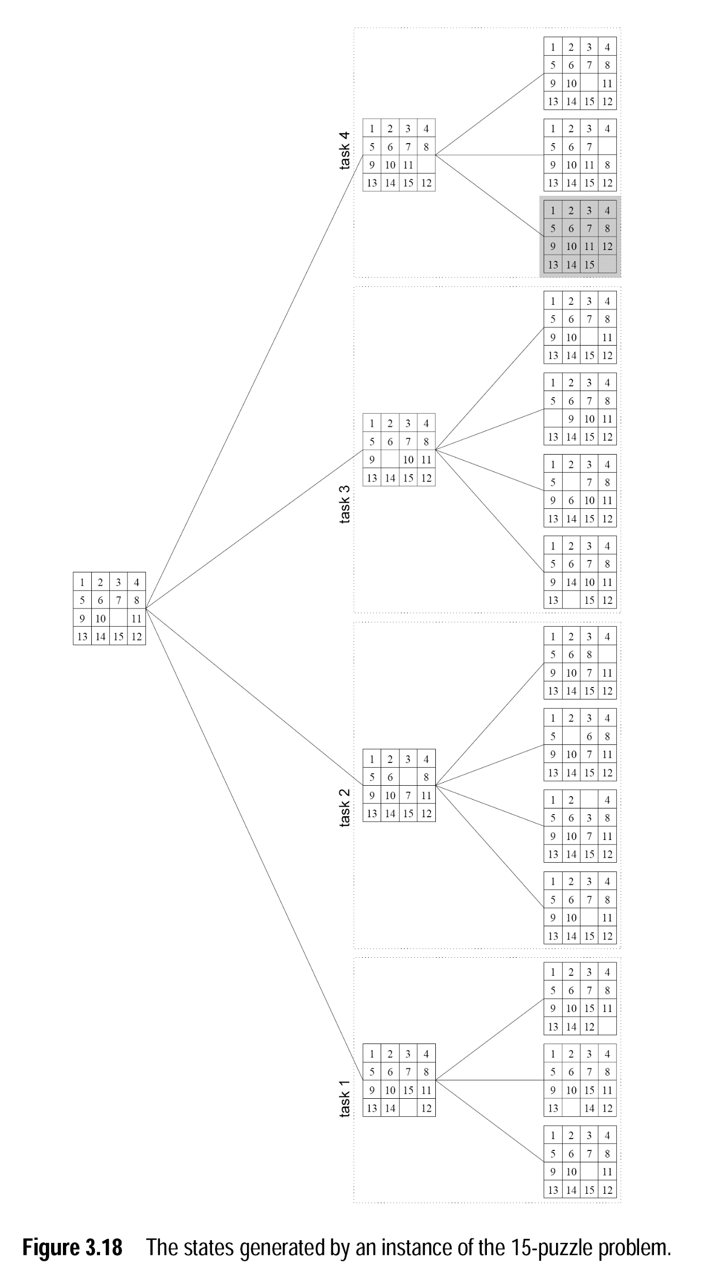
Notes:
In data decomposition, we must complete each task in any case. While in exploratory decomposition, all the tasks terminate as soon as the goal state is found.

Slide 23
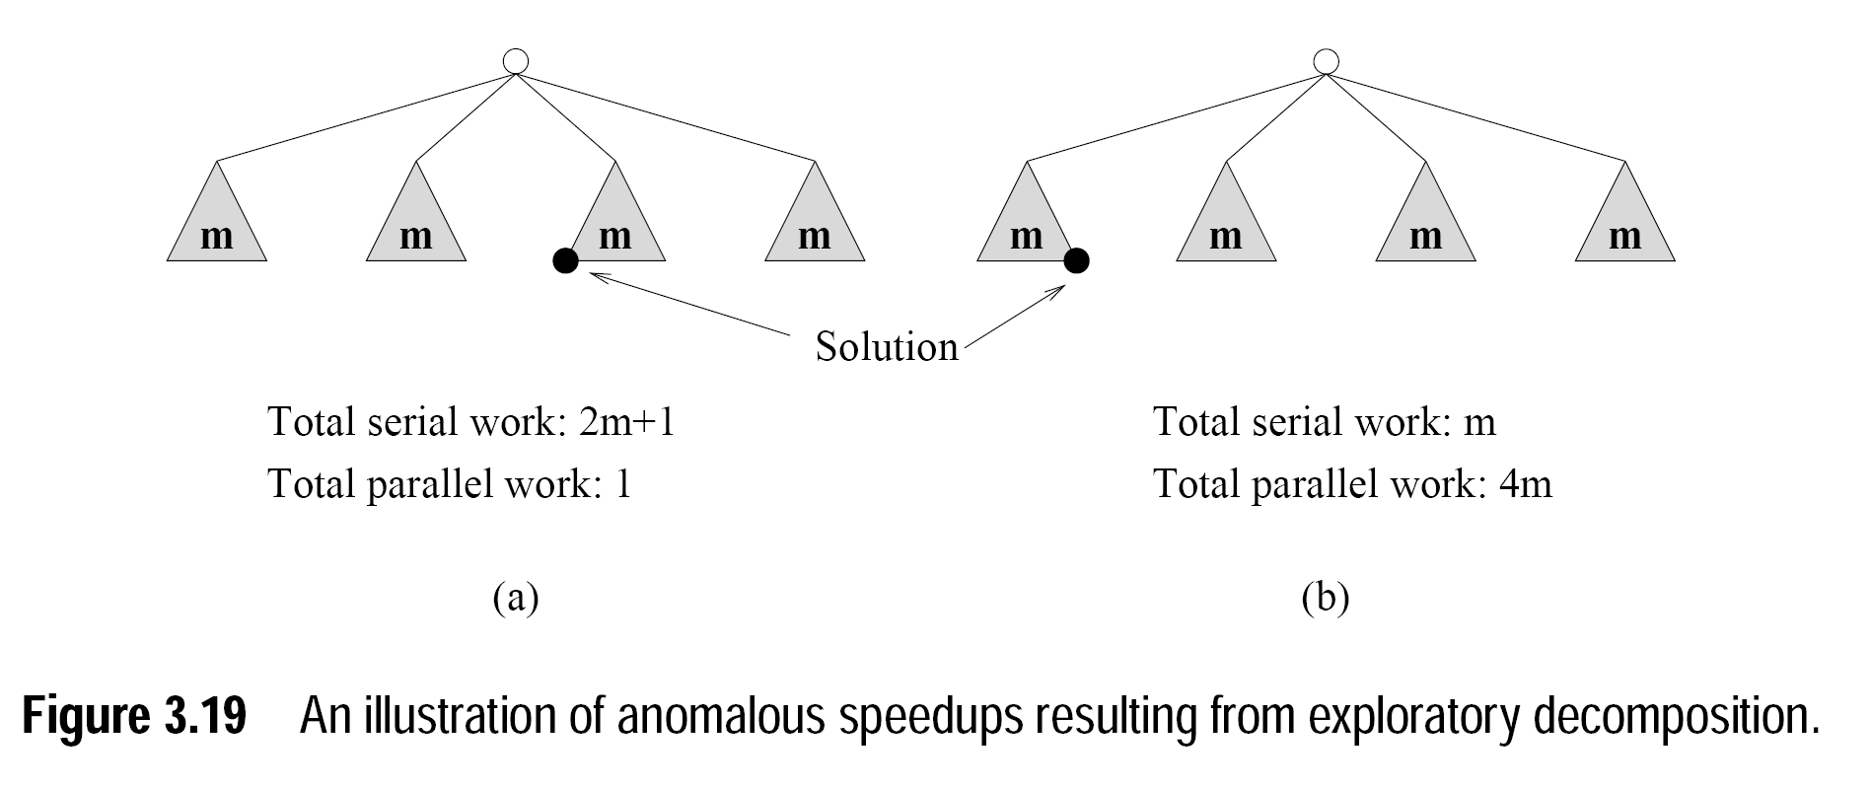
Notes:
Search space explored by parallel and sequential algorithms can be different
3.19 b) Speedups of the parallel formulation fluctuate greatly based on the position of the goal in the search space. Although doing 4 times more work in parallel, but can’t achieve any speedup.

Slide 24
Decomposition Techniques
4. Speculative Decomposition
Usually used in the problems where different input values or output of previous stage causes many computationally intensive branches.
Speculation is something like Gamble or Risk or preliminary guess.
Steps:
Speculate(guess) the output of previous stage
Start performing computations in the next stage before even the completion of the previous stage.
After availability of the output of previous stage, if speculation was correct than most of the computation for next step would have already been done.
Notes:
If speculation was wrong, then you would have to pay overhead of rolling back the computation.
Different from exploratory as input at a branch leading to multiple parallel task is unknown while in exploratory output(result) at each branch is unknown.

Slide 25
Decomposition Techniques
4. Speculative Decomposition
Switch Example Algorithm:
1: Calculate expression for the switch condition → task 0
2: Case 0: Multiply vector b with matrix A → task 1
3: Case 1: Multiply vector c with matrix A → task 2
4: Case 2: Multiply vector d with matrix A → task 3
5: display result → task 4
Notes:
Expression– expression may be calculated based on complex computation of previous data.
While task 0 is completing its execution , task 1 to 3 can start their computation.
Once the output of task 0 is clear, the computation of correct task shall be considered and forwarded for further computation.

Slide 26
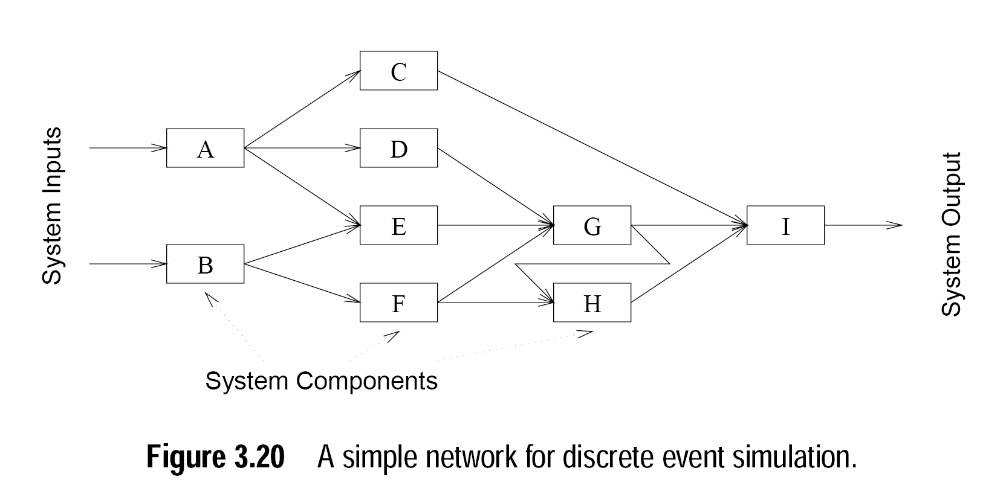
Decomposition Techniques
4. Speculative Decomposition
Notes:
C, D, and E can speculate some input and start computation before A can generate any output. If on the output of A, C’s speculation was correct, then most of the work would have already been completed.

Slide 27
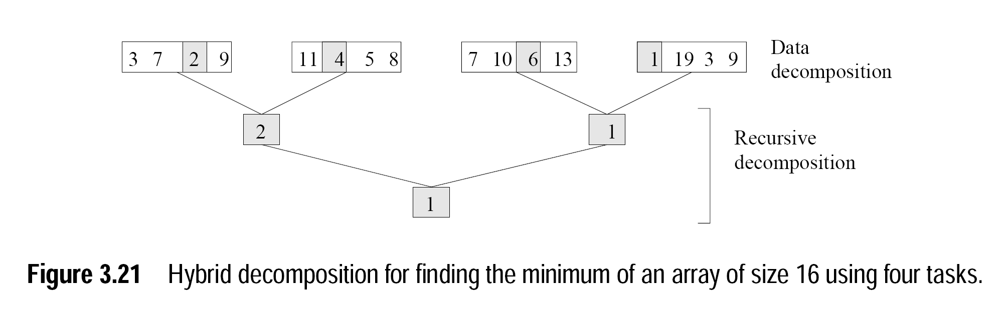
Decomposition Techniques
5. Hybrid Decomposition
Decomposition technique are not exclusive
We often need to combine them together
Notes:
For a larger set of elements, finding minimum using recursive decomposition can generate far more tasks than number of processors.
Better method: partition into P parts, find minimum in each part and combine the results.
Input data decomposition.

Slide 28

Questions

Slide 29
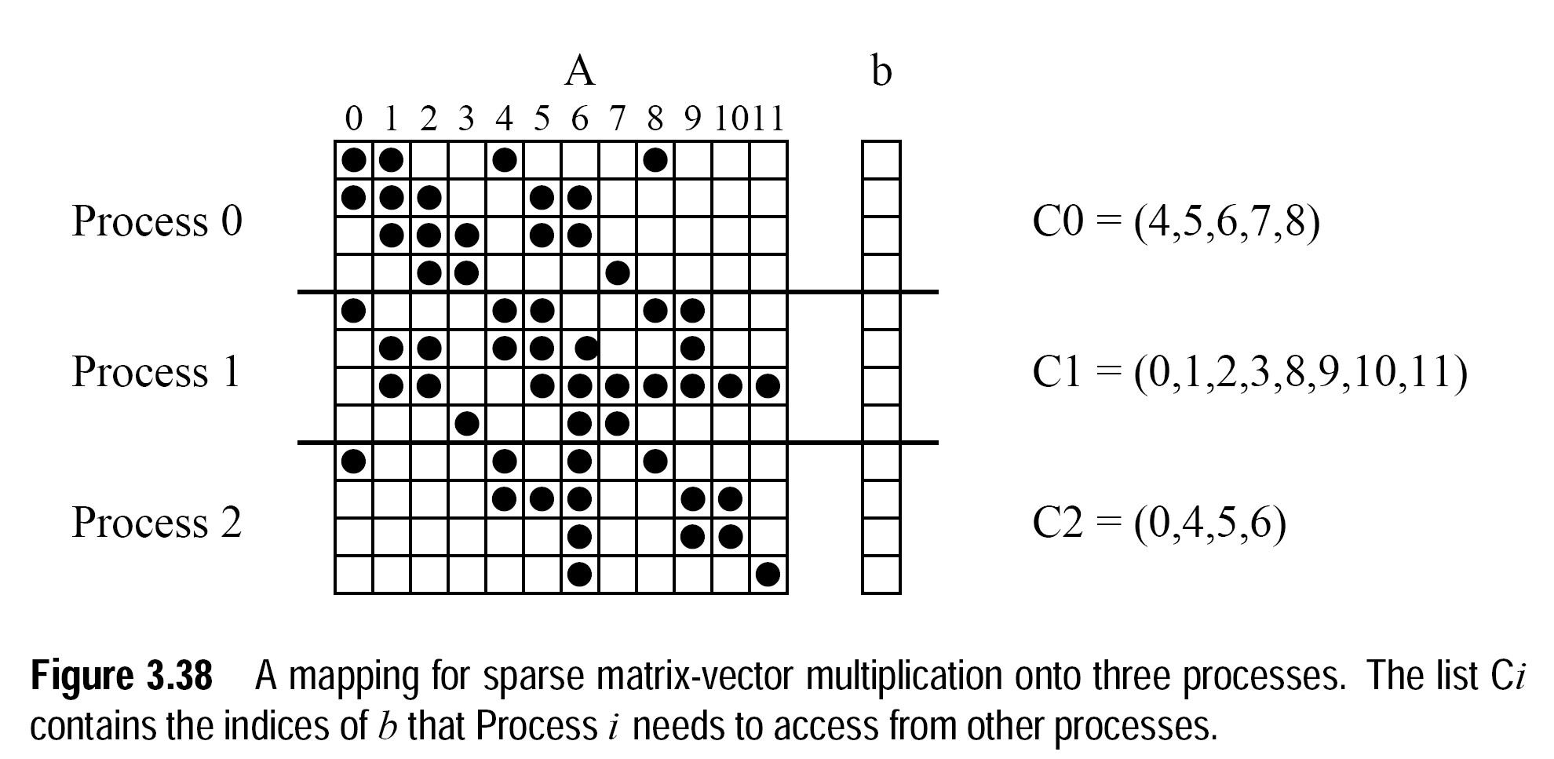

Slide 30
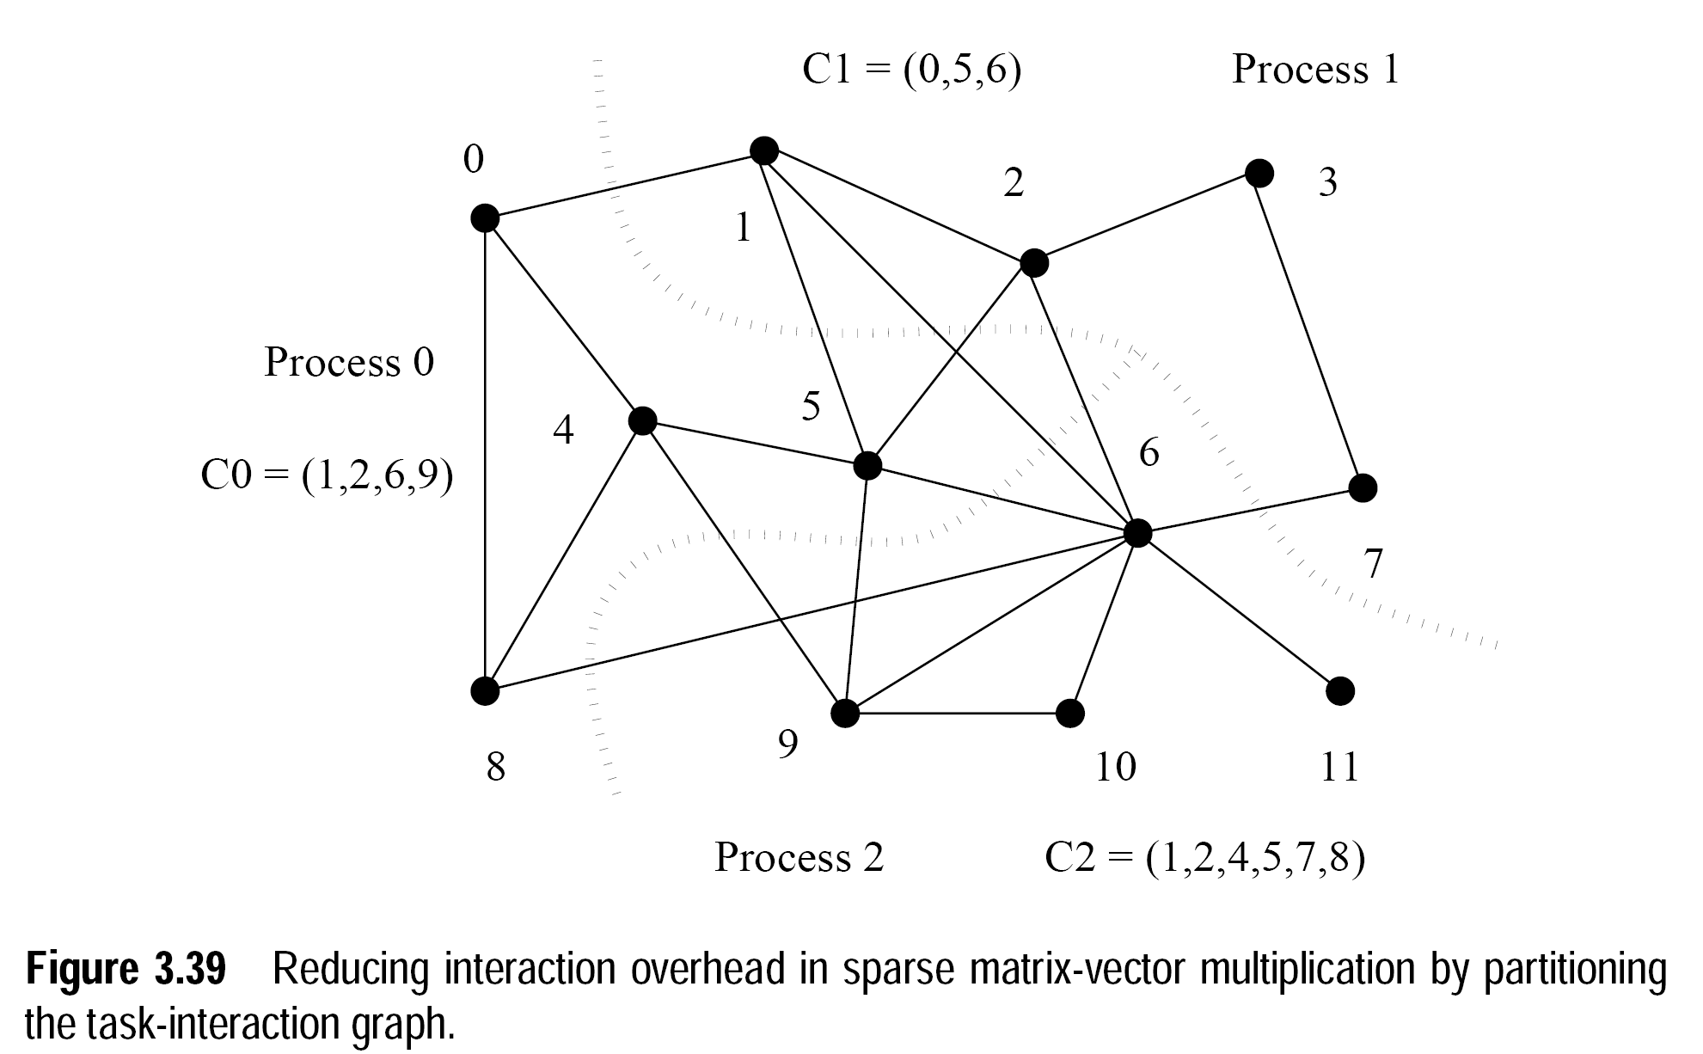

Slide 31
References
Kumar, V., Grama, A., Gupta, A., & Karypis, G. (1994). Introduction to parallel computing (Vol. 110). Redwood City, CA: Benjamin/Cummings.
Quinn, M. J. Parallel Programming in C with MPI and OpenMP,(2003).

